Slide 1
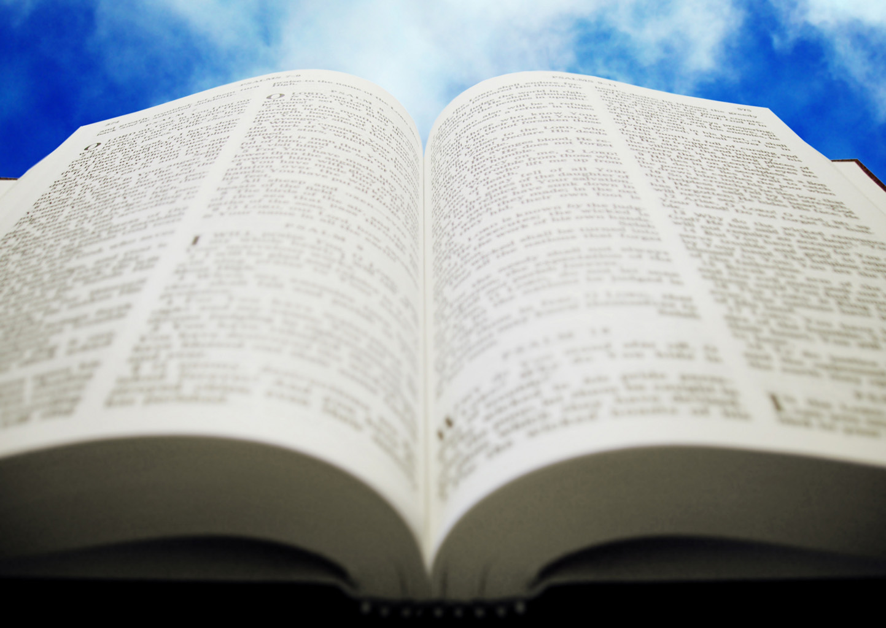
Welcome!
Sunday
Bible Study 9:30 AM
Worship 10:30 AM
Wednesday
Bible Class 7:00 PM
www.SunsetchurchofChrist.net

Slide 2
John 8:21-30
Jesus reveals His goal
Belief in Jesus
Speaking from the Father

Slide 3
Welcome!
Sunday
Bible Study 9:30 AM
Worship 10:30 AM
Wednesday
Bible Class 7:00 PM
www.SunsetchurchofChrist.net

Slide 4
Opening Prayer
Song –
Scripture Reading
Song –
Song –
Lord’s Supper
Song –
Collection
Song –
Lesson | Brian Haines
Song –
Closing

Slide 5
Soul Winners

Slide 6
Soul Winners
1 Corinthians 9:19-22
Becoming all things to all men
Giving up liberties for the sake of others
Result: saving some
Winning the race
Winning souls

Slide 7
Soul Winners
People who convict others
In speech and in deed – Colossians 3:17
Ready with an answer – 1 Peter 3:15
Even for those who are saved
Notes:
Col 3:17 And whatever you do in word or deed, do all in the name of the Lord Jesus, giving thanks to God the Father through Him.

Slide 8
Soul Winners
What is the alternative?
Soul “losers”
People who drive others away from God
People who cannot hold their own hope
Notes:
Col 3:17 And whatever you do in word or deed, do all in the name of the Lord Jesus, giving thanks to God the Father through Him.

Slide 9
Winners and Losers
Soul winners see the lost and grieve
Matthew 9:36
Soul losers see the lost with contempt
Luke 18:10-14
Notes:
Mt 9:36 But when He saw the multitudes, He was moved with compassion for them, because they were weary and scattered, like sheep having no shepherd.
Lu 18:10 "Two men went up to the temple to pray, one a Pharisee and the other a tax collector. 11 "The Pharisee stood and prayed thus with himself, 'God, I thank You that I am not like other men--extortioners, unjust, adulterers, or even as this tax collector. 12 'I fast twice a week; I give tithes of all that I possess.' 13 "And the tax collector, standing afar off, would not so much as raise his eyes to heaven, but beat his breast, saying, 'God, be merciful to me a sinner!' 14 "I tell you, this man went down to his house justified rather than the other; for everyone who exalts himself will be humbled, and he who humbles himself will be exalted."

Slide 10
Winners and Losers
Soul winners have hearts of gratitude
Mark 5:18-20
Soul losers have an attitude of entitlement
Luke 12:17-19
Notes:
Mr 5:18 And when He got into the boat, he who had been demon-possessed begged Him that he might be with Him. 19 However, Jesus did not permit him, but said to him, "Go home to your friends, and tell them what great things the Lord has done for you, and how He has had compassion on you." 20 And he departed and began to proclaim in Decapolis all that Jesus had done for him; and all marveled.
Lu 12:17 "And he thought within himself, saying, 'What shall I do, since I have no room to store my crops?'
18 "So he said, 'I will do this: I will pull down my barns and build greater, and there I will store all my crops and my goods.
19 'And I will say to my soul, "Soul, you have many goods laid up for many years; take your ease; eat, drink, and be merry."'

Slide 11
Winners and Losers
Soul winners love to worship
Psalm 126
Soul losers find the assembly a burden
Malachi 1:13
Notes:
Mal 1:13 You also say, 'Oh, what a weariness!' And you sneer at it," Says the LORD of hosts. "And you bring the stolen, the lame, and the sick; Thus you bring an offering! Should I accept this from your hand?" Says the LORD.

Slide 12
Winners and Losers
Soul winners labor for their own souls
1 Corinthians 9:23-27
Soul losers are bitter and grumble
Jude 16
Notes:
Heb 2:4 God also bearing witness both with signs and wonders, with various miracles, and gifts of the Holy Spirit, according to His own will?
Jude 1:16 These are grumblers, complainers, walking according to their own lusts; and they mouth great swelling words, flattering people to gain advantage.

Slide 13
Why This Matters
Sometimes churches lose focus
Revelation 2:1-7
Caught up on other purposes
Lose sight of overall goals
Notes:
Re 2:1 ¶ "To the angel of the church of Ephesus write, 'These things says He who holds the seven stars in His right hand, who walks in the midst of the seven golden lampstands: 2 "I know your works, your labor, your patience, and that you cannot bear those who are evil. And you have tested those who say they are apostles and are not, and have found them liars; 3 "and you have persevered and have patience, and have labored for My name's sake and have not become weary. 4 "Nevertheless I have this against you, that you have left your first love. 5 "Remember therefore from where you have fallen; repent and do the first works, or else I will come to you quickly and remove your lampstand from its place--unless you repent. 6 "But this you have, that you hate the deeds of the Nicolaitans, which I also hate. 7 "He who has an ear, let him hear what the Spirit says to the churches. To him who overcomes I will give to eat from the tree of life, which is in the midst of the Paradise of God."'

Slide 14
Why This Matters
Sometimes churches lose focus
Sometimes churches don’t WANT to win souls
Difficulty of spiritual immaturity
Difficulty of needing to grow
Notes:
Heb 2:4 God also bearing witness both with signs and wonders, with various miracles, and gifts of the Holy Spirit, according to His own will?

Slide 15
Why This Matters
Sometimes churches lose focus
Sometimes churches don’t WANT to win souls
This is evident when:
Find more problems than solutions
Content to remain the same
Unwilling to try new ideas
Notes:
Heb 2:4 God also bearing witness both with signs and wonders, with various miracles, and gifts of the Holy Spirit, according to His own will?

Slide 16
Application
Where no oxen are, the manger is clean, but much revenue comes by the strength of the ox. Proverbs 14:4
Notes:
Heb 2:4 God also bearing witness both with signs and wonders, with various miracles, and gifts of the Holy Spirit, according to His own will?

Slide 17
Application
As a congregation:
We need to push to reach the lost
We need to help those gifted in this work
We need to reinvigorate that desire
Notes:
Heb 2:4 God also bearing witness both with signs and wonders, with various miracles, and gifts of the Holy Spirit, according to His own will?

Slide 18
Application
As a congregation:
As individual Christians:
We need to want to be soul winners
We need to want to engage the lost
We need to accept the challenges with it
Notes:
Heb 2:4 God also bearing witness both with signs and wonders, with various miracles, and gifts of the Holy Spirit, according to His own will?

Slide 20
Are You In the Kingdom
Hearing and believing
Confessing Jesus as Lord
Repentance
Baptism
Remaining Faithful

